Slide 1
Customer Analytics Case Study
Tailoring Personalized Coupons Through Customer Segmentation

Slide 2
Agenda
Objective: Understanding customer purchasing patterns to boost engagement.
Approach: Customer segmentation through data analysis.
Insights: Sales trends based on segmentation.
Recommendations: Tailored strategies for better customer experience.
Additional Suggestions: Boosting holiday sales and optimizing discounts.
Better understanding our customers

Slide 3
Customer Segmentation
High-Value Customers (20%)
Most profitable, consistent buyers
Loyal Customers (20.8%)
Frequent purchasers, brand advocates
Potential Loyalists (19.8%)
Emerging customers, high growth potential
At Risk Customers (19.4%)
Declining purchases, need retention efforts
Lost Customers (19.9%)
Previously active or one-time customers
Applied RFM Analysis (Recency, Frequency, Monetary) to categorize customers.

Slide 4
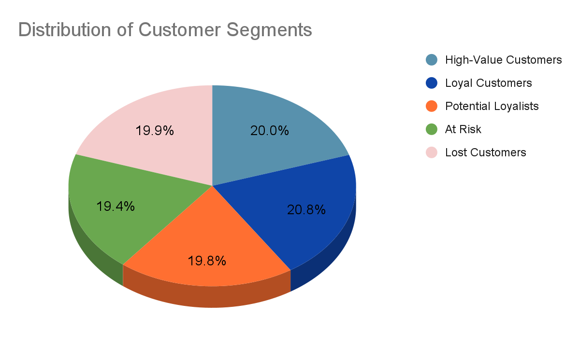
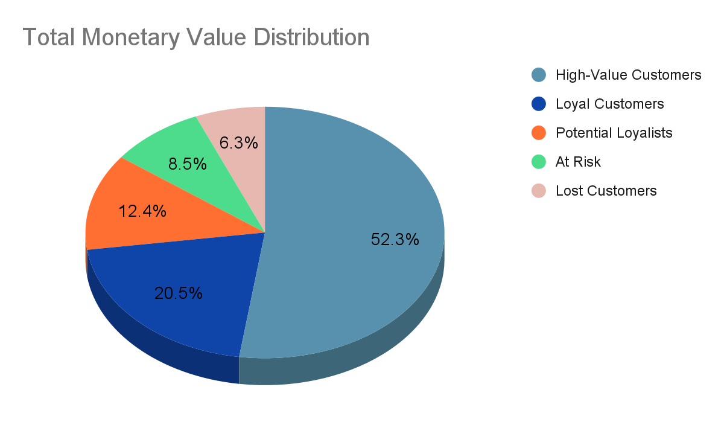
Overview of Sales Based on Customer Segmentation
Key Findings:
High-Value Customers contribute 52.3% of the total monetary value.
Loyal Customers contribute 20.5%, showing strong revenue impact.
Potential Loyalists account for 12.4%, indicating growth potential.
At Risk Customers contribute 8.5%, revealing retention opportunities.
Lost Customers contribute 6.3%, suggesting low-return re-engagement efforts.

Slide 5
Recommendations
High-Value Customers: Offer exclusive, high-value coupons and early access to premium products to maintain loyalty and maximize spend.
Loyal Customers: Provide tiered rewards or discounts to encourage continued engagement and migration to high-value status.
Potential Loyalists: Use targeted campaigns with mid-tier discounts to encourage frequent purchases and brand attachment.
At Risk Customers: Send retention-focused offers like discounts on previously purchased products to regain engagement.
Lost Customers: Minimize investment by offering basic discounts; reallocate efforts to higher-value segments.

Slide 6
Holiday Sales Suggestions
Discount Strategy
Top Performers:
Stock Code 84077 leads with 5,139 units sold.
Popular products include 85123A, 21212, and 22834, driving high holiday engagement.
Segment Insights:
High-Value Customers favor items like 22616 and 22834.
Lost Customers still contribute significantly to specific products, such as 84077.
Potential Loyalists focus on versatile items like 22693.
Top Pairs Bought Together:
22745, 22746 & 22748 with a lift of 48.6+, highlighting bundling opportunities.
23172 & 23171/23170 with exceptional lift values over 49+.
Recommendations:
Introduce tailored holiday bundles targeting customer segments.
Promote high-lift pairs through festive discounts to maximize sales.
Disclaimer: All product values are referenced by their StockCodes.
Notes:
84077- WORLD WAR 2 GLIDERS ASSTD DESIGNS , 85123A - WHITE HANGING HEART T-LIGHT HOLDER, 21212 - PACK OF 72 RETROSPOT CAKE CASES , 22834 - HAND WARMER BABUSHKA DESIGN, 22616- PACK OF 12 LONDON TISSUES, 22693- GROW A FLYTRAP OR SUNFLOWER IN TIN, 22745 -POPPY'S PLAYHOUSE BEDROOM , 22748-kitchen, 22746 - living room , 23172-REGENCY TEA PLATE PINK, 23171-green, 23170-rose

